Slide 1
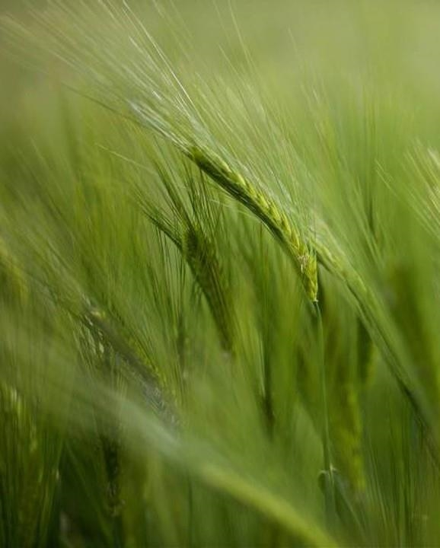
CROP RECOMMENDATION SYSTEM
Manthan Bhegade (b-11)
B.tech Cse
Project guide – dr. Sachin jadhav

Slide 2
INTRODUCTION
Background of the Problem
Agriculture is a crucial part of the Indian economy, supporting over 50% of the population.
Farmers often struggle to choose the appropriate crop for cultivation.
Challenges arise due to:
Lack of awareness about soil health.
Unpredictable climatic conditions.
Limited access to expert agricultural advice.
Traditional farming methods are insufficient for addressing modern agricultural challenges.
Poor crop selection can lead to:
Low agricultural productivity.
Economic losses for farmers.
Negative impacts on food security and rural development.
A scientific and data-driven solution is necessary to help farmers make informed decisions about crop selection.

Slide 3
INTRODUCTION
Importance & Relevance
Advancements in Artificial Intelligence (AI) and Machine Learning (ML) have made data-driven farming solutions feasible and effective.
These technologies can analyze soil and weather parameters to predict the most suitable crop for a specific area.
Precision farming and sustainable agriculture are essential in the modern era to conserve natural resources and boost crop yield.
A crop recommendation system reduces guesswork for farmers by providing accurate and reliable crop suggestions.
This leads to:
Increased agricultural productivity.
Better decision-making for farmers.
Optimal utilization of soil and water resources.

Slide 4
INTRODUCTION
Objective & Scope The main objective of this project is to build a Machine Learning-based Crop Recommendation System that uses input features like Nitrogen (N), Phosphorus (P), Potassium (K), temperature, humidity, pH, and rainfall to suggest the best crop. The scope of this project includes:
Collecting and preprocessing relevant agricultural data.
Applying various machine learning algorithms such as Random Forest, SVM, Decision Tree, XGBoost, etc., to train and evaluate models.
Comparing the models based on performance metrics like Accuracy, Precision, Recall, and F1-score.
Selecting the best-performing model for deployment.
Saving the trained model and preprocessing steps for future prediction use.
This project aims to bridge the knowledge gap between farmers and modern farming techniques by providing an intelligent, user-friendly tool to improve agricultural decision-making.

Slide 5
Literature Review
Research Paper 1: Crop Recommender System Using Machine Learning Approach(2021)
Author : Shilpa Mangesh Pande , Prem Kumar Ramesh , Anmol , B.R Aishwarya , Karuna Rohilla , Kumar Shaurya
Refernce: https://ieeexplore.ieee.org/document/9418351
Publish in: 2021 5th international conference on computing methodologies and communication
The research paper introduces a machine learning-based crop recommendation system.
Aim to help farmers select suitable crops using soil and climate data.
Key features used:
Nitrogen (N), Phosphorus (P), Potassium (K)
Temperature, Humidity, Rainfall
Soil pH
Several ML models were tested; Random Forest achieved the highest accuracy (95%).
The system was integrated into a mobile application (Ionic, AngularJS, ReactJS).
Allows farmers to input data, get crop suggestions, and view weather forecasts.
Future enhancements proposed:
Add more soil features (e.g., organic carbon)
Expand the dataset to more regions
Include fertilizer recommendations
Develop a multilingual user interface
The study shows ML can optimize crop selection and improve agricultural productivity.

Slide 6
Literature Review
Research Paper 2: Intelligent Crop Recommendation System using Machine Learning (2021)
Author: Priyadharshini A, Aayush Kumar, Omen Rajendra Pooniwala, Swapneel Chakraborty
Refernce: https://ieeexplore.ieee.org/document/9418375
Publish in: 2021 5th international conference on computing methodologies and communication
The paper explores how machine learning (ML) can assist farmers in selecting the most suitable crop for their land based on soil composition and environmental conditions.
Traditional crop selection methods based on experience are often inaccurate due to climate change and soil degradation, which lead to low yields and poor resource usage.
The dataset includes key parameters such as Nitrogen, Phosphorus, Potassium, temperature, humidity, rainfall, and pH, which influence crop growth.
Various ML algorithms were tested:
Decision Tree – for rule-based classification
Random Forest – for ensemble learning
Support Vector Machine (SVM) – for optimized boundaries
K-Nearest Neighbors (KNN) – for similarity analysis
Naïve Bayes – for probabilistic classification
Among these, Random Forest achieved the highest accuracy, showing its effectiveness in predicting the best crop by reducing errors and improving reliability.
The study highlights the role of ML in delivering data-driven crop recommendations, which can increase productivity, reduce losses, and promote sustainable agriculture.
Future work includes adding more features like soil texture and pest data, expanding the dataset to cover diverse regions, and developing a mobile app for easier farmer access.

Slide 7
Literature Review
Feature / Criteria | Research Paper 1 | Research Paper 2
Title | Crop Recommender System Using ML Approach | Crop Recommendation Using Machine Learning
Authors | Shilpa M. Pande, Prem K. Ramesh, Anmol, et al. | Priyadharshini A, Aayush Kumar, Omen Rajendra Pooniwala, Swapneel Chakraborty
Publication Year & Source | 2021, IEEE 5th Int. Conf. on Computing Methodologies and Communication | IEEE (Publication year 2021)
Aim | Recommend best crop using ML based on soil and climate parameters | Improve crop selection through ML considering soil & weather factors
Features Used | N, P, K, temperature, humidity, pH, rainfall | N, P, K, temperature, humidity, pH, rainfall
ML Algorithms Tested | RF, DT, SVM, NB, KNN, LR | RF, DT, SVM, NB, KNN
Best Performing Model | Random Forest (95% accuracy) | Random Forest (highest accuracy)
Application Integration | Mobile App using Ionic, AngularJS, ReactJS; includes OpenWeather API | Suggests app development as future enhancement
Output | Predicts best crop and provides weather data | Predicts best crop based on input parameters
Unique Points | Actual implementation in mobile app with weather API | Focused on ML accuracy, emphasizes sustainability and scalability
Future Scope | Add soil nutrients, fertilizer suggestions, multilingual UI | Include pest data, soil texture, expand dataset, develop mobile app

Slide 8
Methodology
1. Collection of Dataset • A dataset is collected containing various agricultural features such as Nitrogen (N), Phosphorus (P), Potassium (K), temperature, humidity, pH, and rainfall. • The dataset also includes the label, which is the type of crop grown under those conditions.
2. Feature Extraction • From the dataset, meaningful features (N, P, K, temperature, humidity, pH, rainfall) are selected. • These features are used to train the machine learning model.
3. Algorithm Applied • Different machine learning algorithms such as Support Vector Machine (SVM), Decision Tree, and Logistic Regression are used to train the model. • The model learns patterns from the training dataset to associate conditions with the most suitable crop.
4. Recommendation System • When a user provides input through the web interface, the system uses the trained model to predict the best crop based on the entered conditions. • The model is tested using a testing dataset or real-time input from users.
5. Output: Recommended Crop & Pest Removal Technique • The system outputs the recommended crop to be cultivated under the given environmental and soil conditions. • Optionally, the system may also suggest pest removal techniques (if that feature is implemented in future versions).

Slide 9
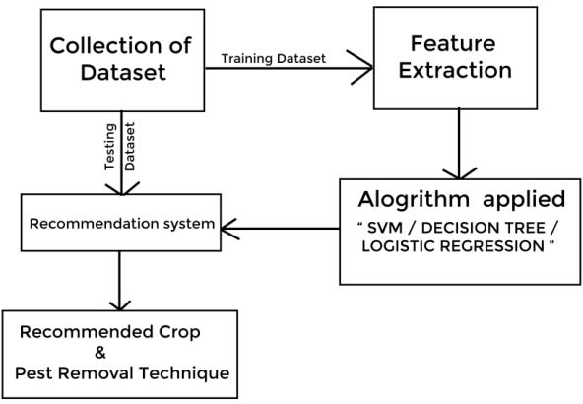
Methodology
Figure: work of flow

Slide 10
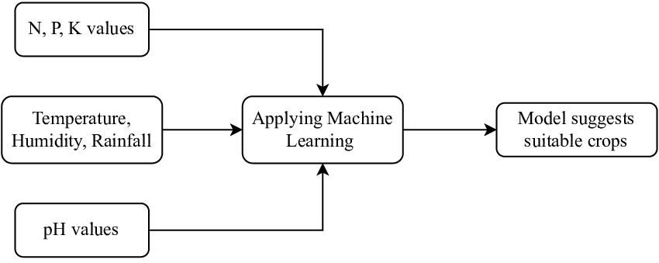
System Design
System Architecture:
The system takes soil & environmental parameters as input.
It processes the data using a trained ML model.
The model predicts the most suitable crop for the given conditions.

Slide 11
Project Implementation
1. Random Forest
Usage: An ensemble of decision trees that vote for the best crop.
Why: High accuracy and handles overfitting better than individual trees.
In Project: Improves prediction by combining multiple crop classification results.
2. Support Vector Machine (SVM)
Usage: Finds the optimal boundary (hyperplane) to separate crop classes.
Why: Works well with high-dimensional feature space (like N, P, K, pH, etc.).
In Project: Classifies crops with clear boundaries in the input features.
3. K-Nearest Neighbors (KNN)
Usage: Recommends a crop based on the most similar data points nearby.
Why: Non-parametric and simple, ideal for quick and intuitive predictions.
In Project: Suggests crops similar to those used in similar environmental conditions.
4. Decision Tree
Usage: Uses feature-based decisions (e.g., if humidity > X, recommend Y).
Why: Easy to understand and visualize.
In Project: Build a flowchart of conditions to classify the best crop.
5. XGBoost
Usage: An advanced boosting algorithm that focuses on correcting prediction errors.
Why: Extremely accurate and efficient for tabular data.
In Project: Refines the crop recommendation with minimal error.
6. Logistic Regression
Usage: Uses a sigmoid function to predict the probability of crop classes.
Why: Good for linearly separable classes and interpretable results.
In Project: Provides a probability-based prediction for the most suitable crop.

Slide 12
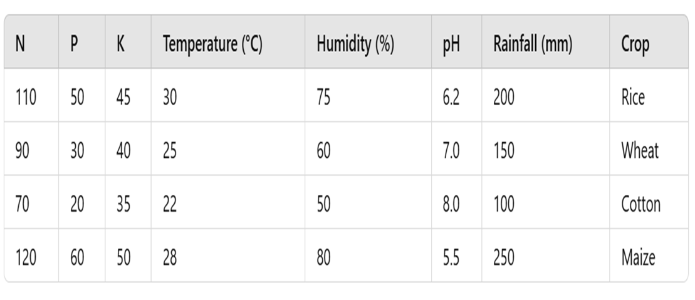
DATASET
Fig. sample data
Nitrogen (N): Supports leaf and plant growth.
Phosphorus (P): Boosts root development and flowering.
Potassium (K): Enhances disease resistance and water absorption.
Temperature: Affects seed germination and crop health.
Humidity: Influences moisture level and pest activity.
pH Level: Measures soil acidity; affects nutrient availability.
Rainfall: Provides essential water; impacts yield.
Crop Label: Indicates the best crop for given conditions.

Slide 13
Research Output & Model Performance
The trained models were evaluated based on multiple performance metrics: accuracy, precision, recall, and F1-score.
Findings:
- XGBoost and Random Forest performed the best in terms of accuracy, precision, recall, and F1-score.
- Support Vector Machine (SVM) and KNN had moderate performance but were computationally expensive.
- Decision Tree provided fair results but was prone to overfitting.
- Logistic Regression had the lowest accuracy as it is better suited for binary classification rather than multi-class classification.
- The final model was selected based on the highest accuracy and ability to generalize well on test data.
Key Achievements:
- Successfully developed an intelligent crop recommendation system.
- The model can assist farmers in making scientific decisions to enhance productivity.

Slide 14
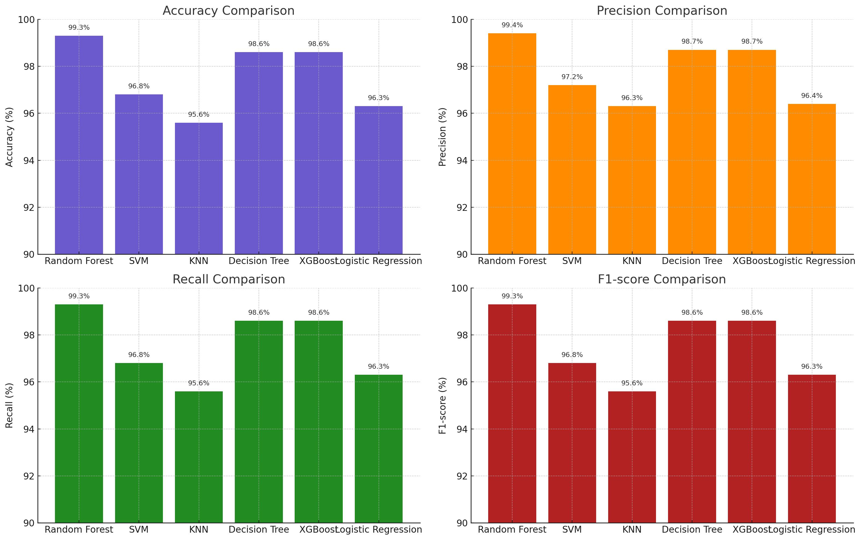
Algorithm Comparison
Random Forest performed the best across all metrics.
Other models like XGBoost and Decision Tree also showed strong results.
Simpler models like KNN and Logistic Regression performed moderately well.
Model | Accuracy | Precision | Recall | F1-score
Random Forest | 99.3% | 99.4% | 99.3% | 99.3%
SVM | 96.8% | 97.2% | 96.8% | 96.8%
KNN | 95.6% | 96.3% | 95.6% | 95.6%
Decision Tree | 98.6% | 98.7% | 98.6% | 98.6%
XGBoost | 98.6% | 98.7% | 98.6% | 98.6%
Logistic Regression | 96.3% | 96.4% | 96.3% | 96.3%

Slide 15
Conclusion & Future Scope
Conclusion:-
The crop recommendation system offers accurate and reliable suggestions for farmers.
It enhances decision-making by utilizing machine learning techniques.
This project effectively bridges the gap between technology and agriculture.
Future Scope:-
- Integration of real-time weather updates for more precise recommendations.
Expansion of the dataset to include pest and disease predictions.
Development of a mobile application to improve accessibility for farmers.
This system has the potential to revolutionize the agricultural sector by enabling farmers to make informed decisions and enhance crop yields.

Slide 16
Reference
Research Paper:
Crop Recommender System Using Machine Learning Approach (Year – 2021)
Author - Shilpa Mangesh Pande , Prem Kumar Ramesh , Anmol , B.R Aishwarya , Karuna Rohilla , Kumar Shaurya
Refernce: https://ieeexplore.ieee.org/document/9418351
Publish in: 2021 5th international conference on computing methodologies and communication
Intelligent Crop Recommendation System using Machine Learning (Year – 2021)
Author - Priyadharshini A , Aayush Kumar , Omen Rajendra Pooniwala , Swapneel Chakraborty
Refernce: https://ieeexplore.ieee.org/document/9418375
Publish in: 2021 5th international conference on computing methodologies and communication

Slide 17
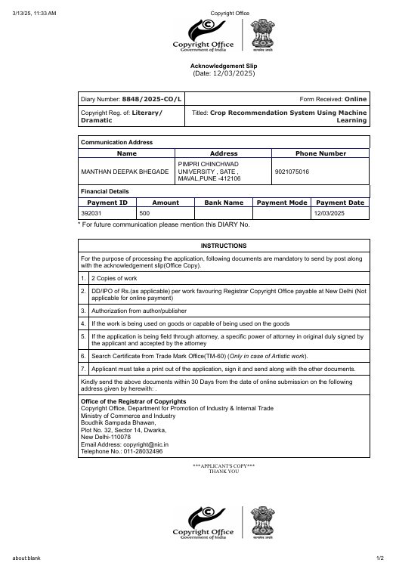
Outcome
Copyright Details:-
Diary Number: 8848/2025-CO/L
Documentation –
..\..\Copyright Office.pdf
..\..\Copyright Office-1.pdf

Slide 18

Thank you

